Slide 1
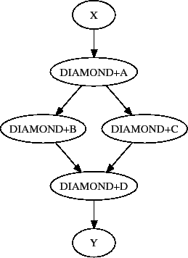

Using HTCondor and DAG
Directed Acyclic Graph Manager

Slide 2
Step Two for Single Room Cluster
Hardware - Set up RAID 10 with 4 4TB hard drives on main server. Configure home directories, common software area and long term storage area.
Configure central password server - RedHat IPA. Have most of the documentation written.
Set up Puppet on main server - Migrate current modules to main server
Set up Cobbler on main server - Kickstart files for each machine. Implement new disk partitioning scheme.
Set up a GITHUB account and repository for OUR cluster. Put all of the configuration information in our GITHUB repository.
We need a name for our cluster?

Slide 3
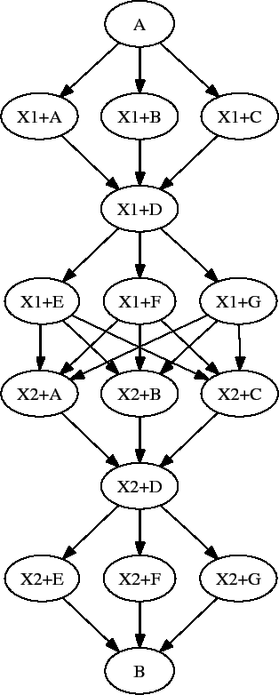
DAGman
A directed acyclic graph (DAG) can be used to represent a set of programs where the input, output, or execution of one or more programs is dependent on one or more other programs.

Slide 4
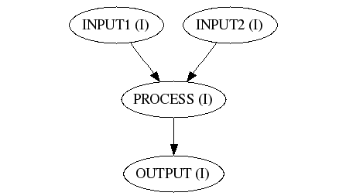
Sample DAG Configuration File
JOB J01 INPUT1
JOB J02 INPUT2
JOB J03 PROCESS
JOB J04 OUTPUT
PARENT J01 J03
PARENT J02 J03
PARENT J03 J04

Slide 5
New HTCondor Feature
This code defines the output to be “output.dat”, but then remaps (renames) it to “output/count$INT(line).dat”. The variable “line” is the line number from the input Arguments file.
transfer_output_files = output.dat line = $(Row)+1 transfer_output_remaps = "output.dat=output/count$INT(line).dat"

Slide 6
Another new HTCondor Feature
Using files to pass values to condor_submit
Submit many jobs with one HTCondor submit file
Condor configuration file directive “Queue”
Queue transfer_input_files,arguments from InputData.lst
Sample line from InputData.lst:
inputs/Alices_Adventures_in_Wonderland_by_Lewis_Carroll.txt,
-f Alices_Adventures_in_Wonderland_by_Lewis_Carroll.txt -o output.dat

Slide 7
Class 16 Agenda: Directed Acyclic Graph
Date: April 26, 2018 Objective: Finish the previous HTCondor Tutorial Directed Acyclic Graphs Doing more on your own
Class 16 Slides: Class 16 - Directed Acyclic Graph
Support documents for the in-class work: DAGMan Applications HOWTOs Condor Submit File
In-class documentation: Class 16 - HTCondor Directed Acyclic Graph Manager

